Slide 1
Bike Rental System

Slide 2
Introduction
This project is intended to be used by a Bike Rental Company that specializes in renting bikes to consumers.
It is a website where clients can view available bikes, register, view profiles, and book bikes.

Slide 3
Problem Statement
Getting a rental bike helps people get around despite the fact they do not have access to their own personal vehicle or don't own a vehicle at all.
The individual who needs a bike must contact a bike rental company and contract out for a vehicle.

Slide 4
Objectives :
To produce a web-based system that allow customer to register and reserve bike online and for the company to effectively manage their bike rental business.
To ease customer’s task whenever they need to rent a bike.

Slide 5
Technology Used :
Programming Language:
ReactJS - Frontend
Node.js + Express.js - Backend
MongoDB – Database
Others :
Tailwind CSS - CSS
Redux Toolkit - State Management Tool
BcryptJS - Hashing Password
Json Web Token - Authorization and Authentication

Slide 6
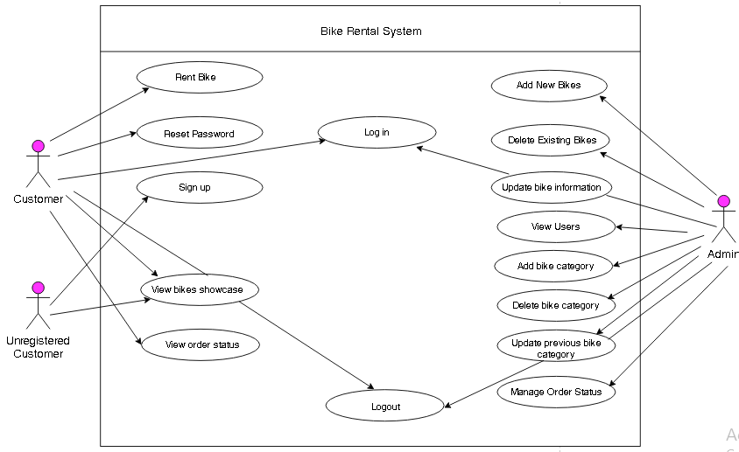
Use Case Diagram

Slide 7
Conclusion
Improved Customer Satisfaction
Increased Operational Efficiency
Better inventory management

